Slide 1

Employee Scheduler <//PRG //>
Assessment Task Presentation
https://github.com/Andrew-Ayman123/time-schedule-manager

Slide 2

<//About me//>
My name is Andrew Ayman
Ain Shams, Computer Engineering 2025 Fresh Grad.
Interned in previous companies like Microsoft and Raisa Energy.
Love problem solving on Leetcode.

Slide 3
Table of contents
01
02
03
04
<//
//>
Problem Description
Architecture
Features
Demo
05
Future Work

Slide 4

Problem Description
<//
//>
Time-consuming manual scheduling: Managers spend hours weekly creating staff schedules by hand
Employee complaints: Staff unhappy with unfair shift distribution and scheduling conflicts
Excessive overtime costs: Poor scheduling leads to unnecessary overtime expenses
Need automated solution: Client wants intelligent system to streamline scheduling process

Slide 5
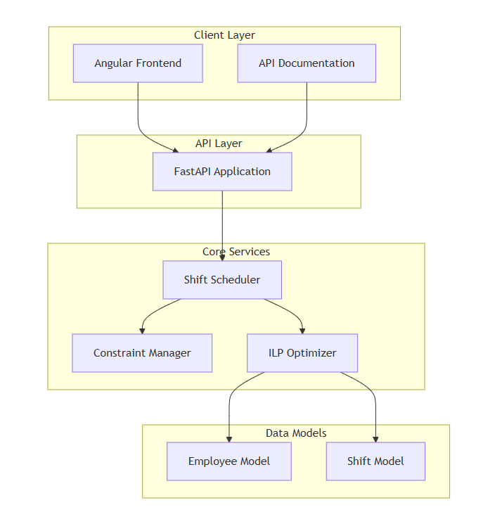
Back-End Architecture
<//
//>

Slide 6
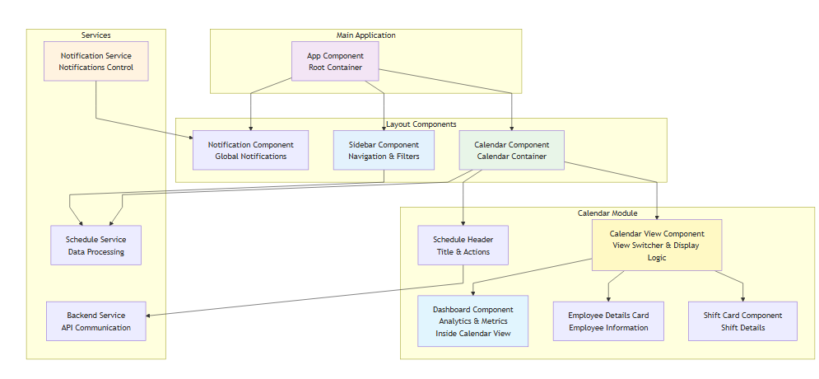
Front-End Architecture
<//
//>

Slide 7







Features
<//
//>
CSV Handling
Responsive UI
Greedy Solver
Backend Integration
Manual Selection
Calendar View
Dashboard

Slide 8
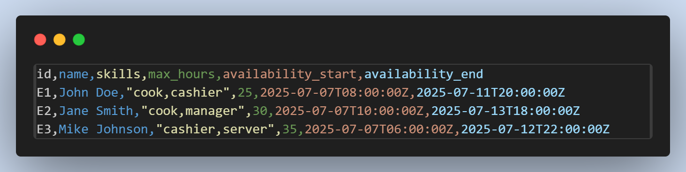
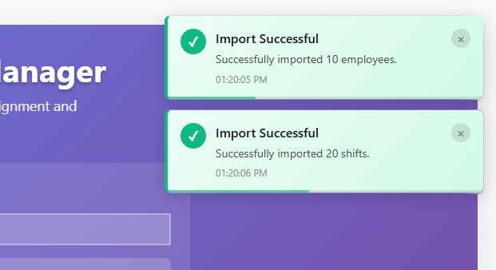
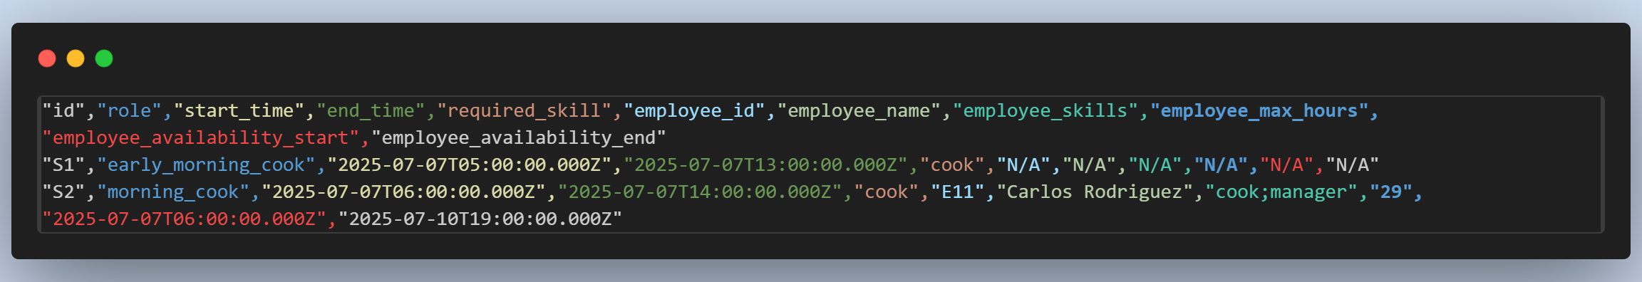
CSV Handling
<//
//>
Importing employee and shifts CSV from local files
Exporting assigned shifts in flat CSV table.

Slide 9
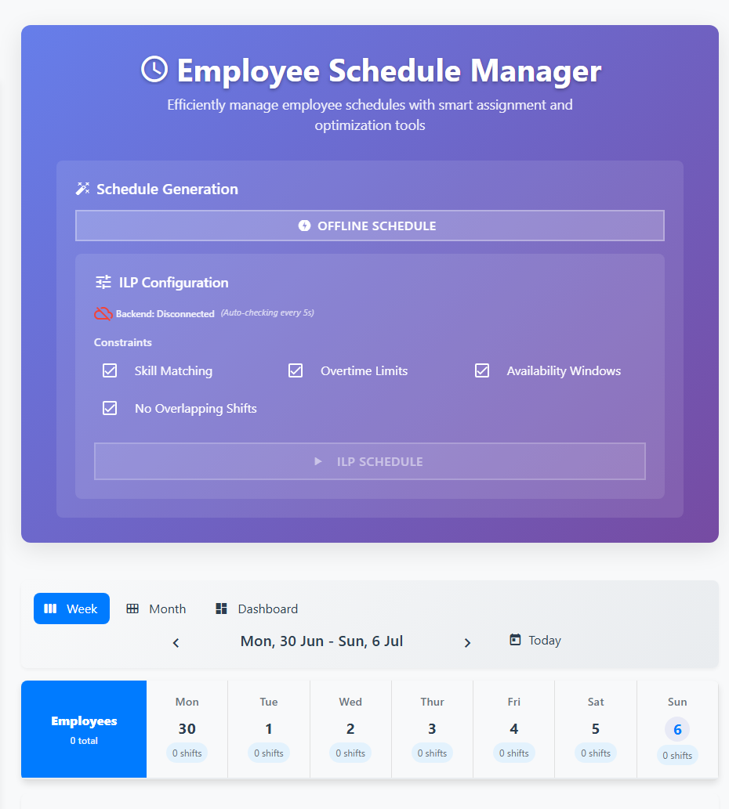
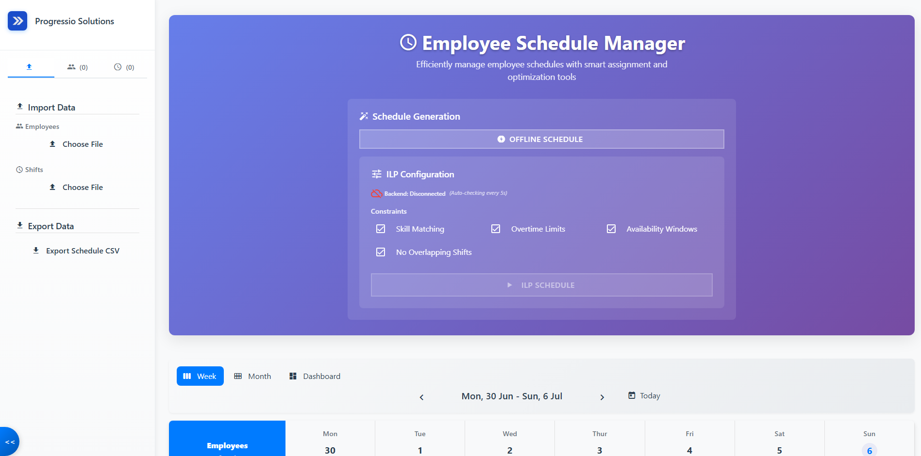
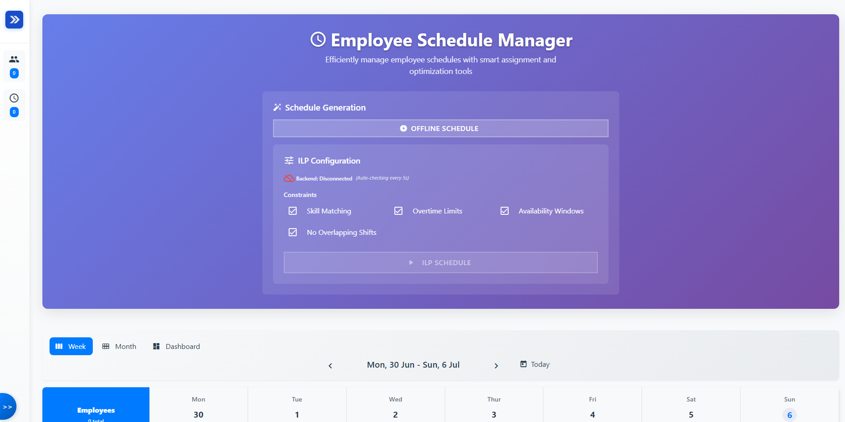
Responsive UI
<//
//>
Used material angular components and bootstrap.
Usage of signals inside services for UI state management.

Slide 10
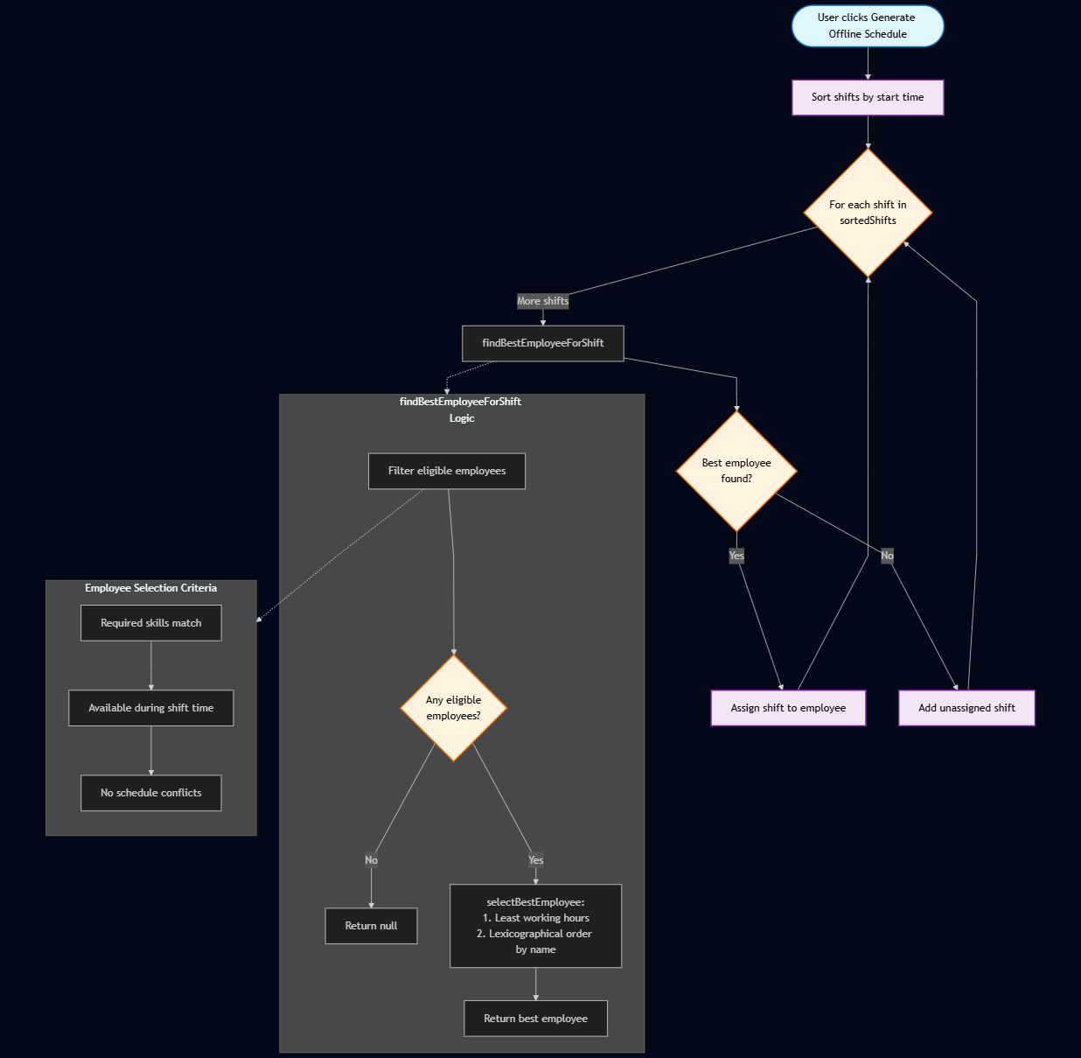
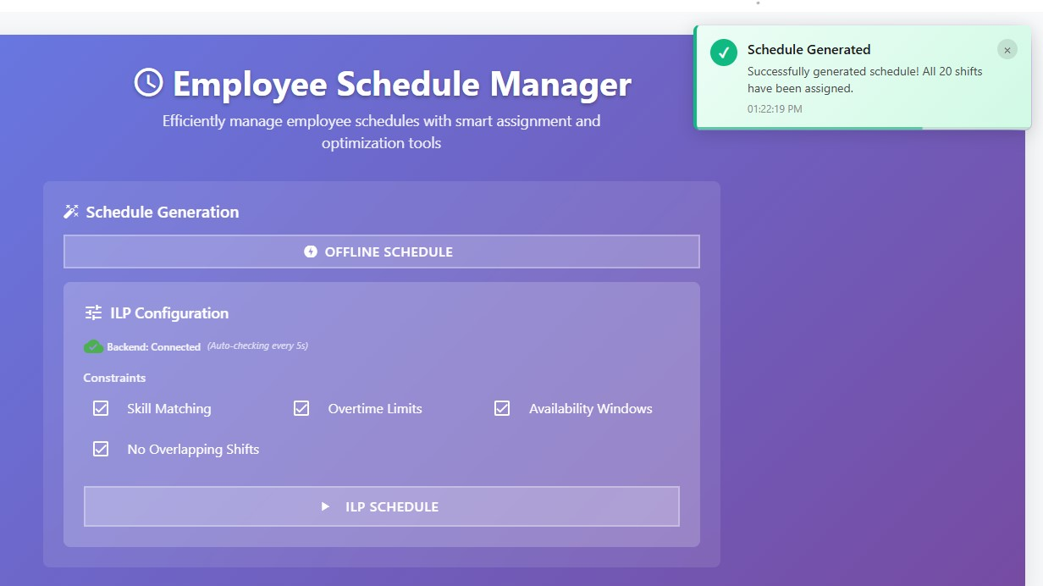
Greedy Solver
<//
//>
Working offline greedy solver.
It schedule s based on the required skills, available shift duration and no shift conflicts (No overtime consideration).

Slide 11
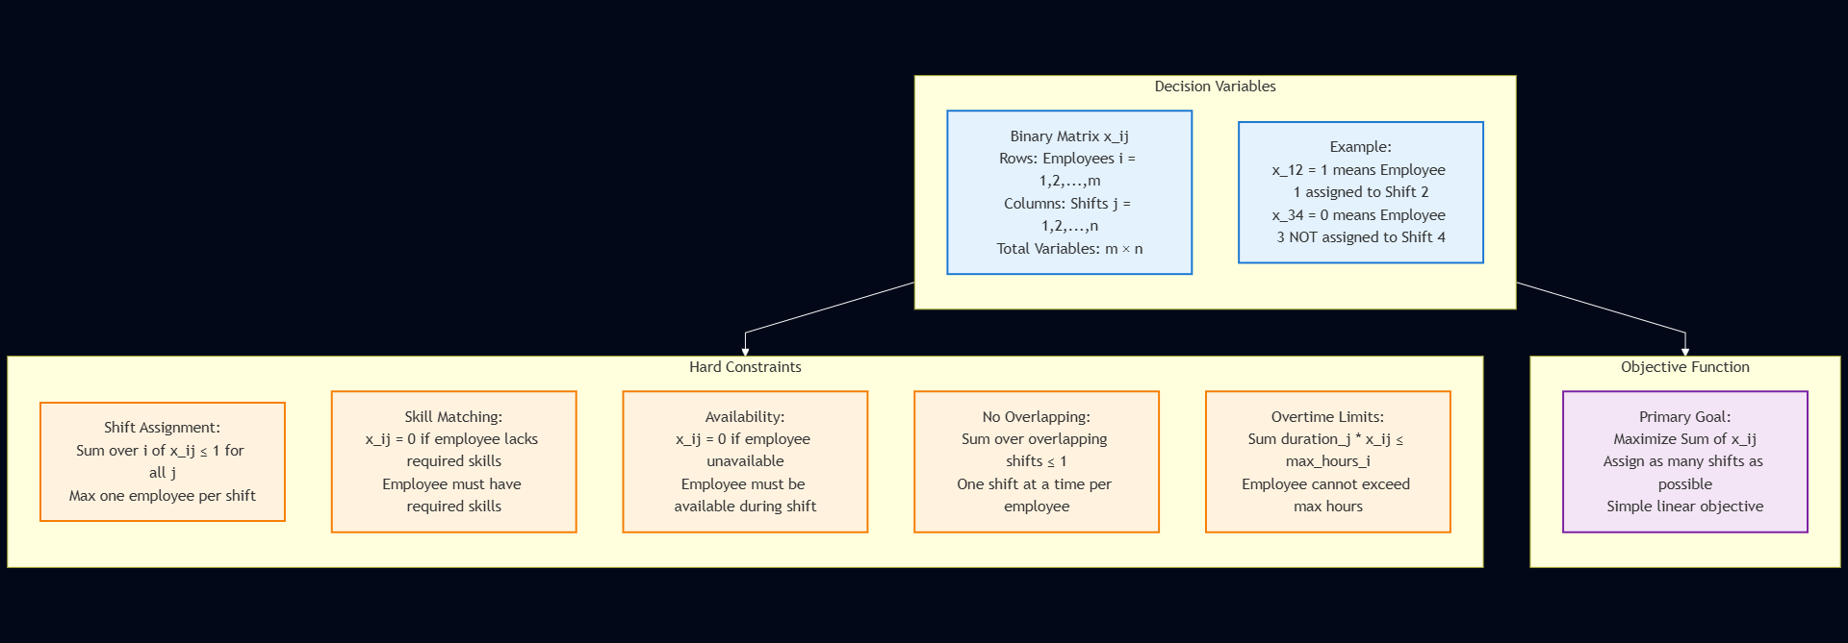
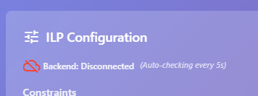
Back-End Integration
<//
//>
Auto detection of backend health.
Advanced schedule with ILP through the backend PuLB solver.

Slide 12
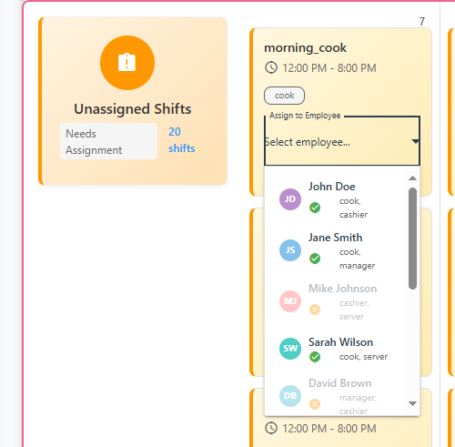
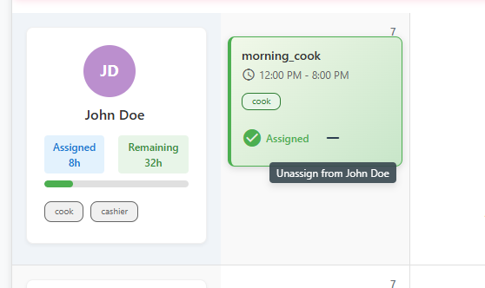
Manual Selection
<//
//>
User can manually assign shifts to employees with disabled if it’s invalid.
User can manually unassign employees to shifts.

Slide 13
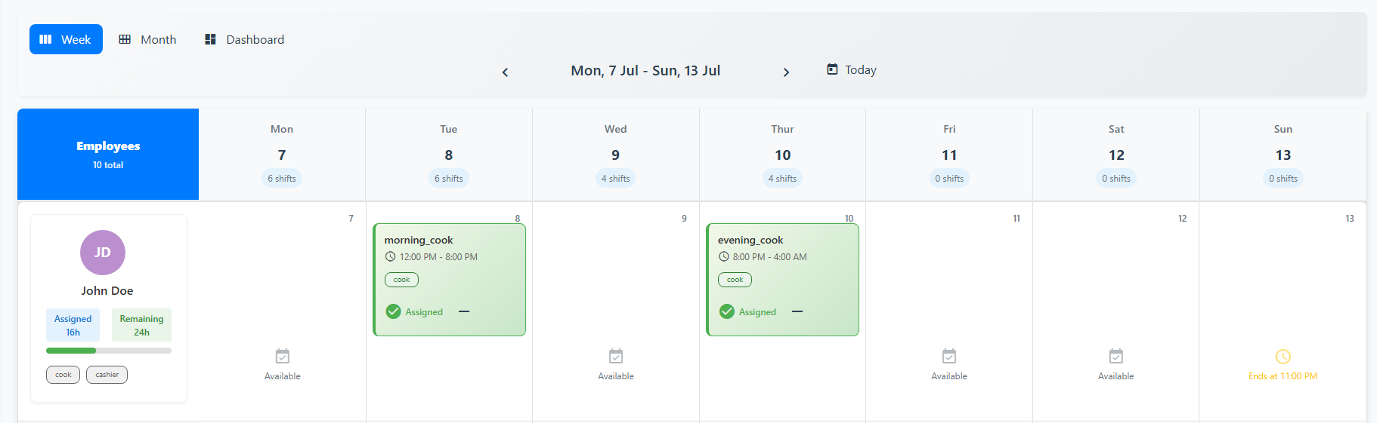
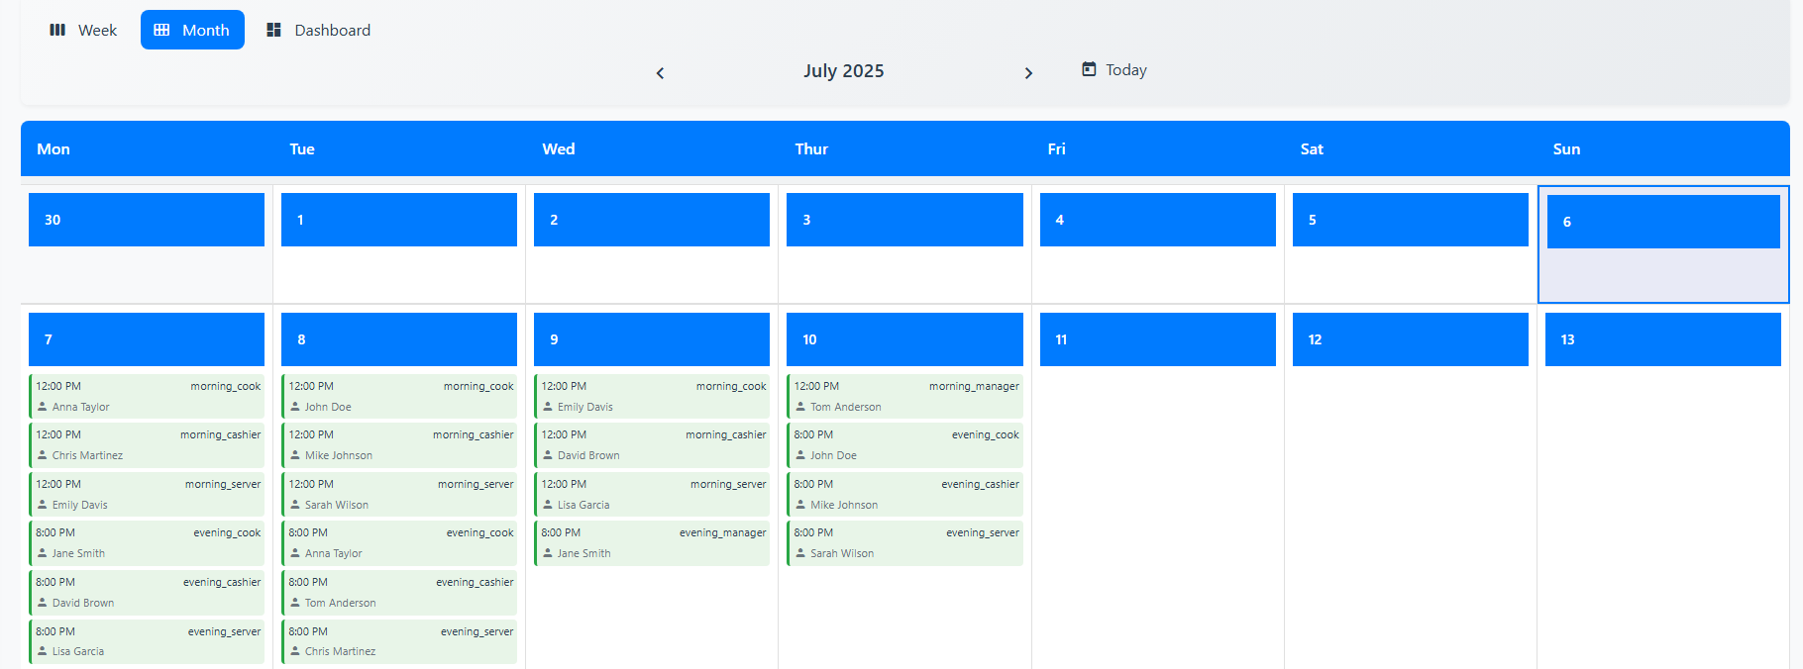
Calendar View
<//
//>
Calendar view for week and month support.
Quick info about the number of shifts per day, per employee and if the employee has overtime.

Slide 14
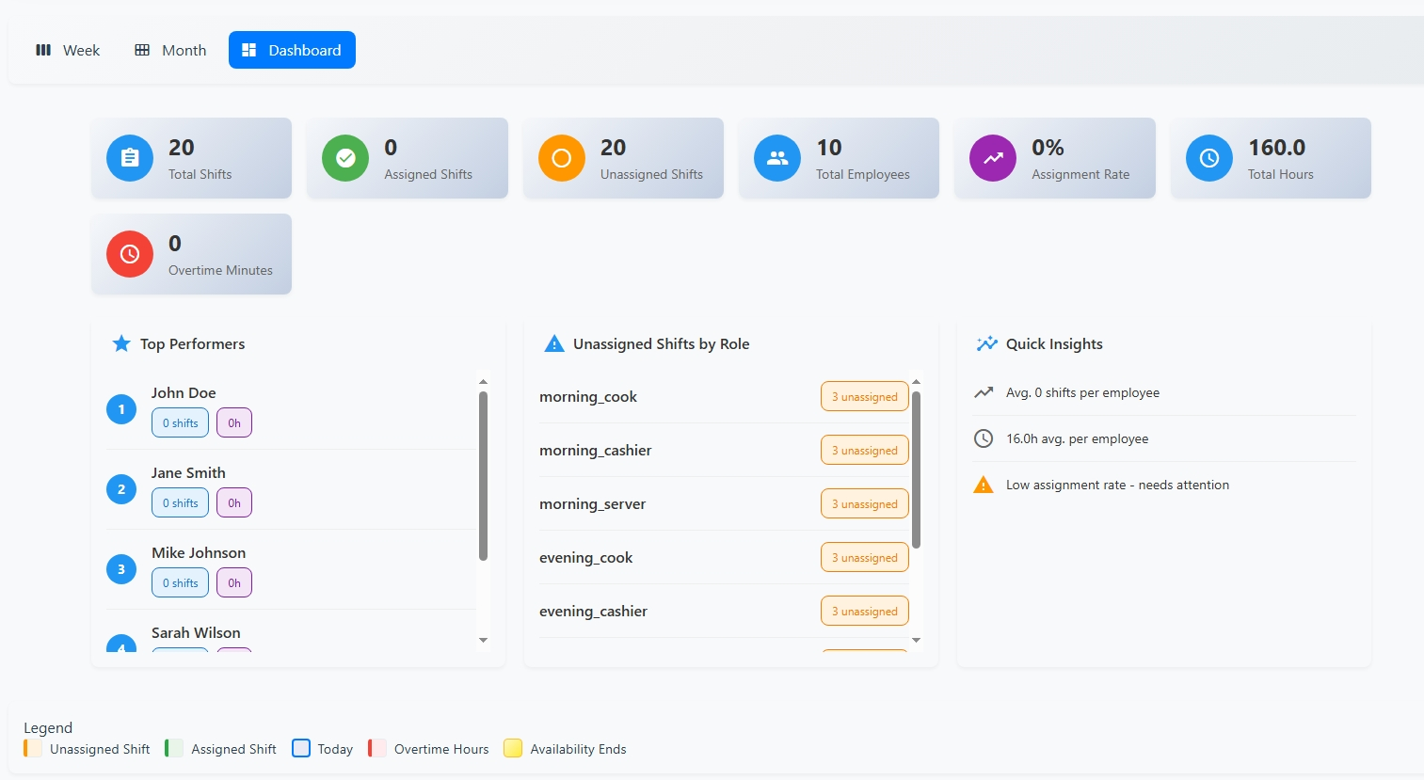
Dashboard
<//
//>
Insights about the schedule:
Number of shifts scheduled
Number of unassigned shifts
Total overtime minutes
Top scheduled employees (those with the most hours assigned)

Slide 15
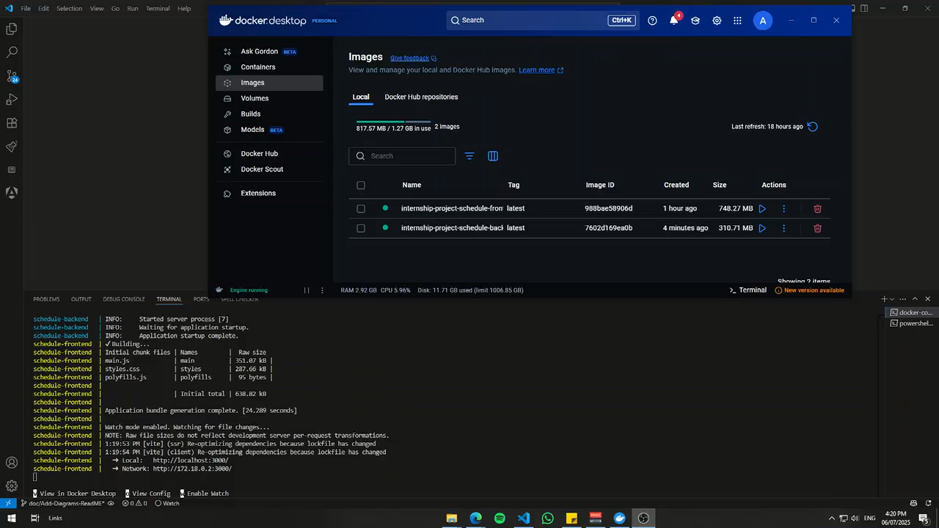
Demo
<//
//>

Slide 16







Future Work
<//
//>
Real-Time
Collaboration
Dark Mode Support
Chart.js Dashboard
UI Lazy loading
More
Constraints
Database
Support
Automated
Email Schedule

Slide 17
<//Thank You//>

